Slide 1
SCD_Final

Slide 2
data: ALFF、FC
Label(scores) : MOCA、AD8
methods : R-boruta
挑選最佳參數
顯示5次交叉驗證的結果(5次平均值) : 為了選擇模型(MLPR、XGBR、LGBMR)
使用最佳參數的模型進行訓練(ALL trainig data)
生成shap圖
生成shap values
shap values & 原始資料做分群
clinical Data
Feature_selection
Gridsearch+cv
Model training
Cluster

Slide 3
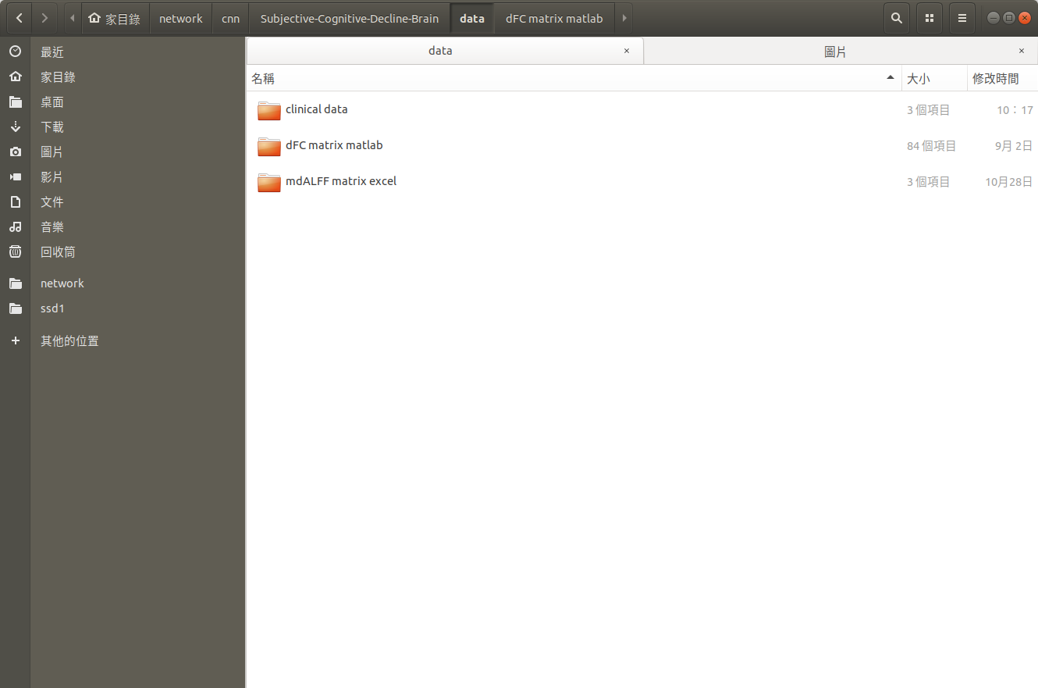
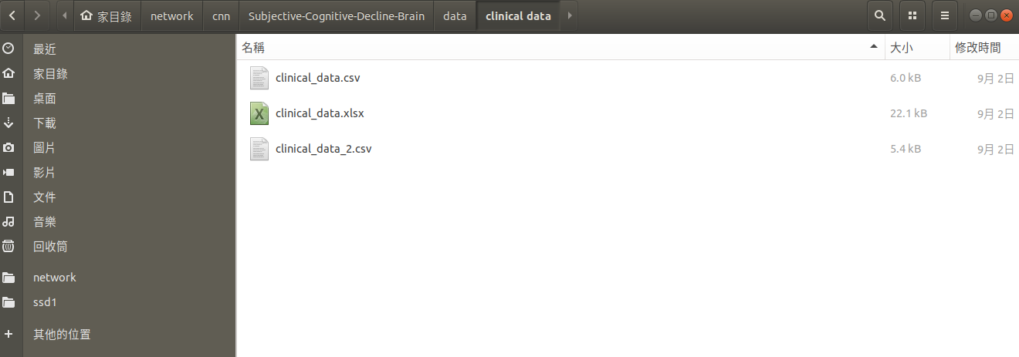
Clinical data
各病人的AD8 & MOCA 原始數據
其中C0018 資料有問題，所以剔除 (85->84)
使用 clinical_data_2.csv

Slide 4
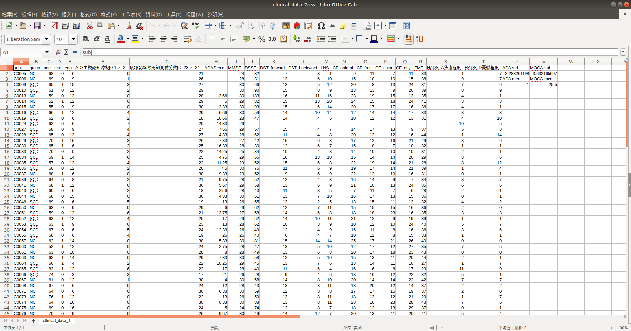
Clinical data labels

Slide 5
Feature_selection

Slide 6
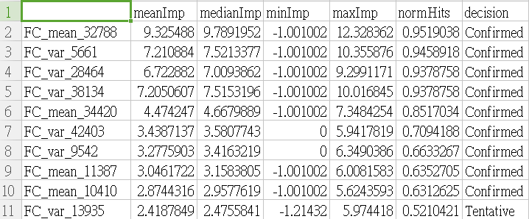
Feature selection
R-boruta select mix(var+mean) data
Numbers
10
R_boruta_select_FC_MOCA_Mix

Slide 7
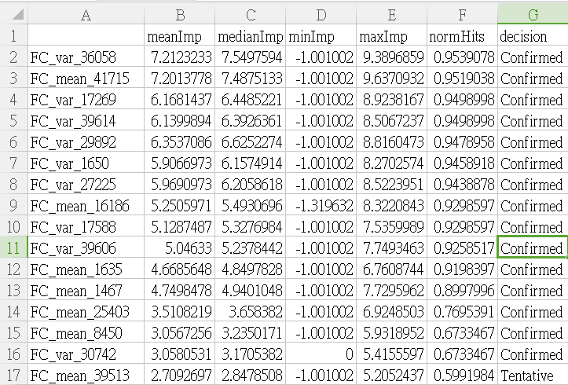
Feature selection
R-boruta select mix(var+mean) data
Numbers
16
R_boruta_select_FC_AD8_Mix

Slide 8
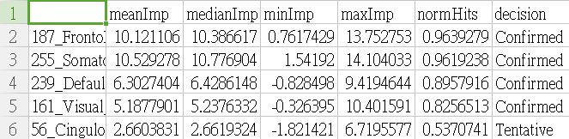
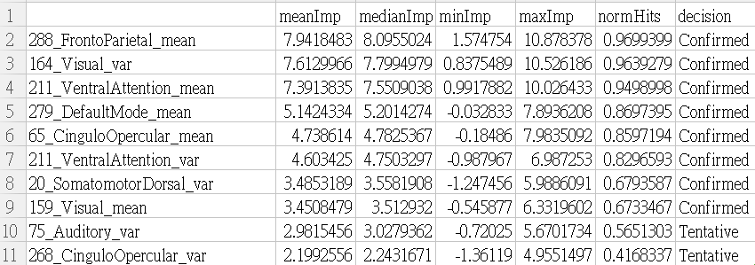
Feature selection
R-boruta select mix(var+mean) data
Numbers
5
R_boruta_select_ALFF_MOCA_mix
Numbers
10
R_boruta_select_ALFF_AD8_mix

Slide 9
Model performance

Slide 10
Model performance
目的: 提供一個依據來選擇 MLPR、XGBR、LGBMR 哪個模型較優
流程:
1.Run Gridsearch (從給定的不同參數中，選出各模型最佳的參數)
2. 選出的結果存起來
3.各模型使用選出的參數組合做交叉驗證 (k=5) : 為了比較出 MLPR、XGBR、LGBMR 哪個模型較優
4.表中的數值為5次交叉驗證結果的平均值 (數值)
5. 拿掉MAPE 的原因: 公式上不適合
使用到的metrics:
Mean absolute error (MAE)
Mean squared error (MSE)
Root-mean-square deviation (RMSE)

Slide 11
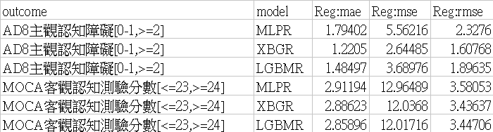
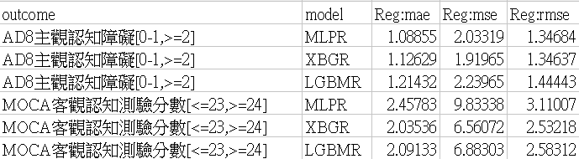
Model performance
code : Regression_Feature_Selection(Final).ipynb
File folder : metrics_Result
ALFF
FC

Slide 12
Model training

Slide 13
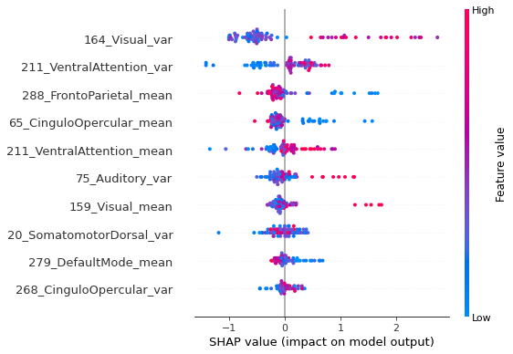
Model training shap
目的: 跑shap、shap values
code : Model_shap_summary(Final).ipynb
ALFF_AD8(XGB)

Slide 14
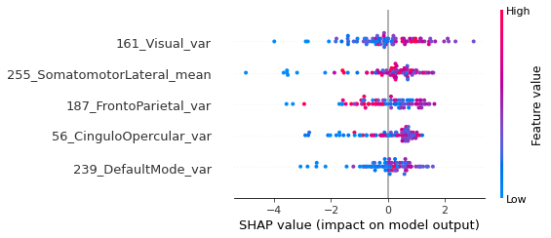
Model training shap
ALFF_MOCA (XGB)

Slide 15
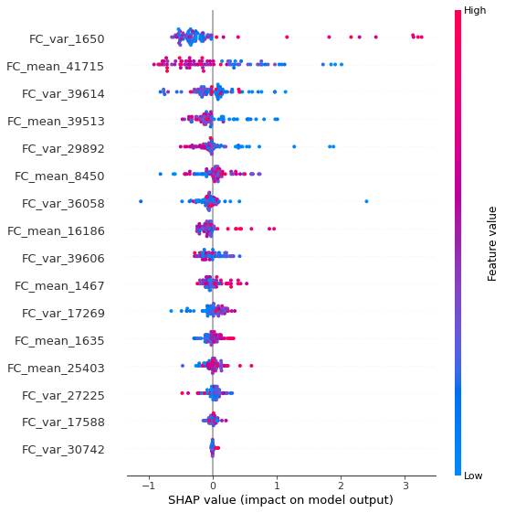
Model training shap
FC_AD8 (XGB)

Slide 16
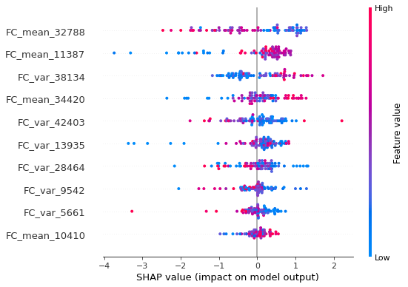
Model training shap
FC_MOCA (XGB)

Slide 17
update
(mean + var + cv)

Slide 18
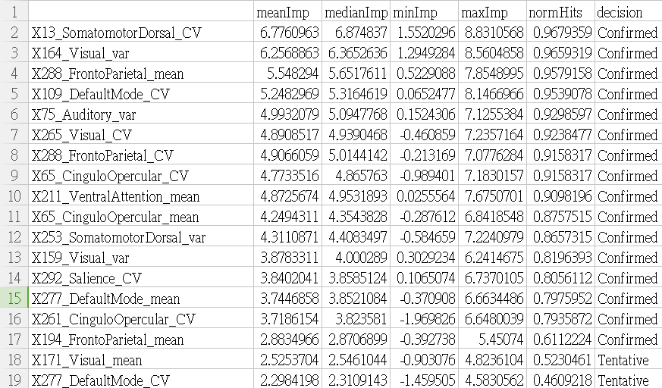
Feature selection
R-boruta select mix(var+mean+cv) data
ALFF_AD8(mean+var+cv)
Total | cv
18 | 8
ALFF_AD8(mean+var)

Slide 19
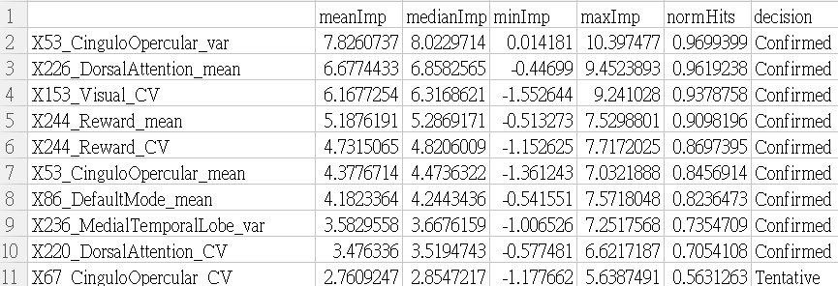
Feature selection
R-boruta select mix(var+mean+cv) data
ALFF_MOCA(mean+var+cv)
Total | cv
10 | 4
ALFF_MOCA(mean+var)

Slide 20
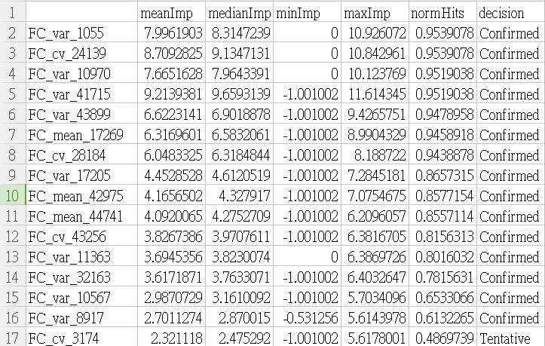
Feature selection
R-boruta select mix(var+mean+cv) data
Total | cv
16 | 4
FC_AD8(mean+var+cv)
FC_AD8(mean+var)

Slide 21
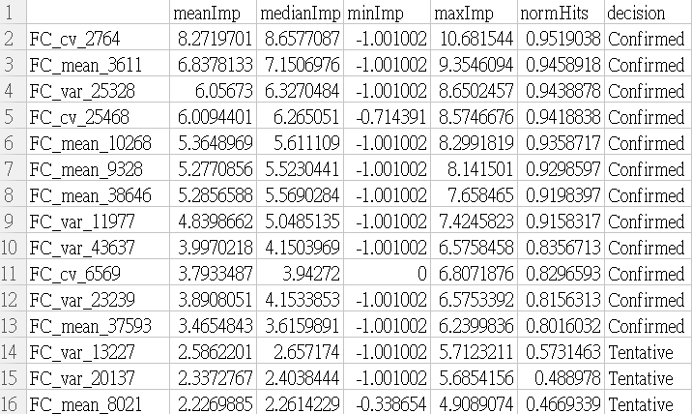
Feature selection
R-boruta select mix(var+mean+cv) data
FC_MOCA(mean+var+cv)
Total | cv
15 | 3
FC_MOCA(mean+var)

Slide 22
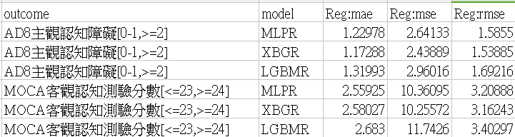
Model performance
ALFF(mean+var+cv)
ALFF(mean+var)

Slide 23
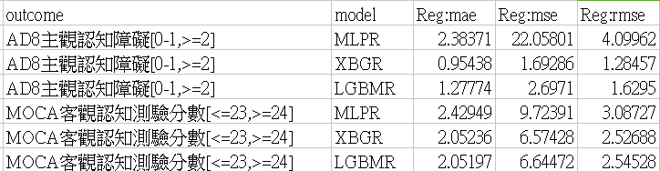
Model performance
FC(mean+var+cv)
FC(mean+var)

Slide 24
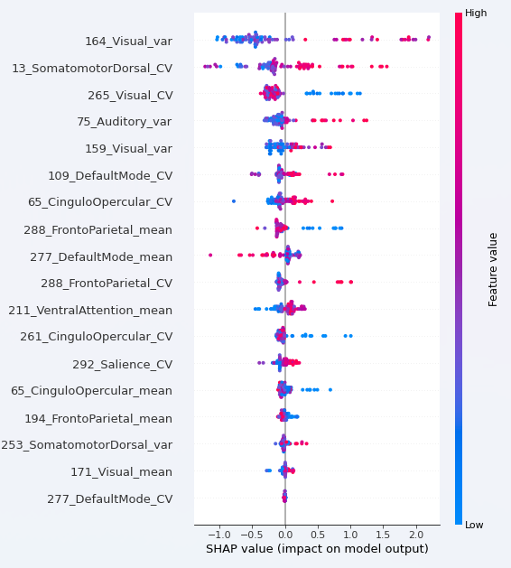
Model training shap
ALFF_ (mean + var + cv) _AD8
ALFF_ (mean + var ) _AD8

Slide 25
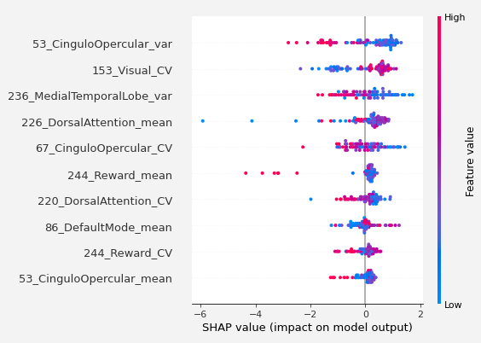
Model training shap
ALFF_ (mean + var + cv) _MOCA
ALFF_ (mean + var ) _MOCA

Slide 26
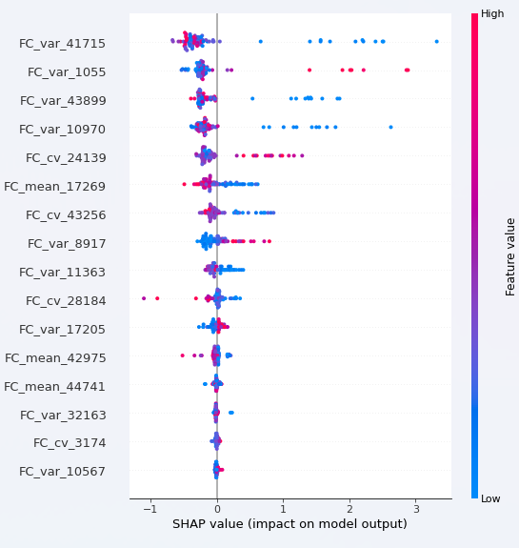
Model training shap
FC_ (mean + var + cv) _AD8
FC_ (mean + var ) _AD8

Slide 27
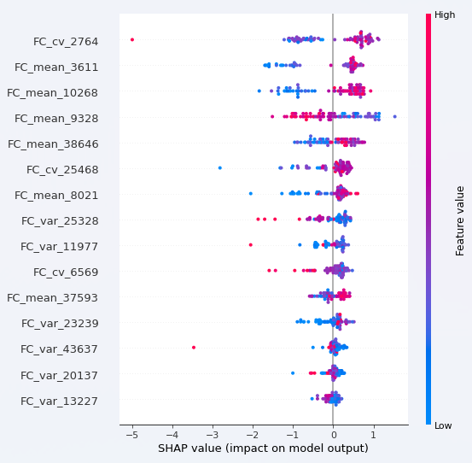
Model training shap
FC_ (mean + var + cv) _MOCA
FC_ (mean + var ) _MOCA

Slide 28
update
(catboost)

Slide 29
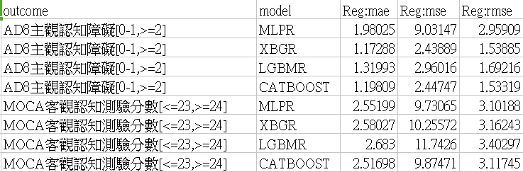
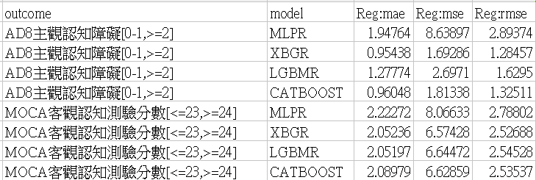
ALFF(mean+var+cv)
FC(mean+var+cv)

